Slide 1
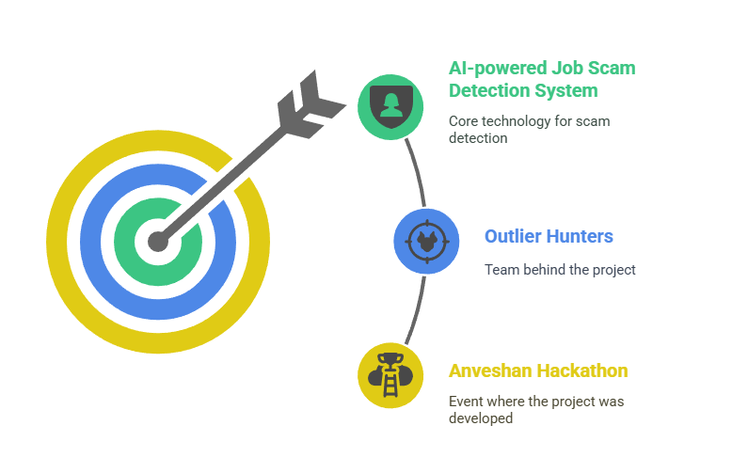
🎯 Spot The Scam — Hackathon Presentation

Slide 2
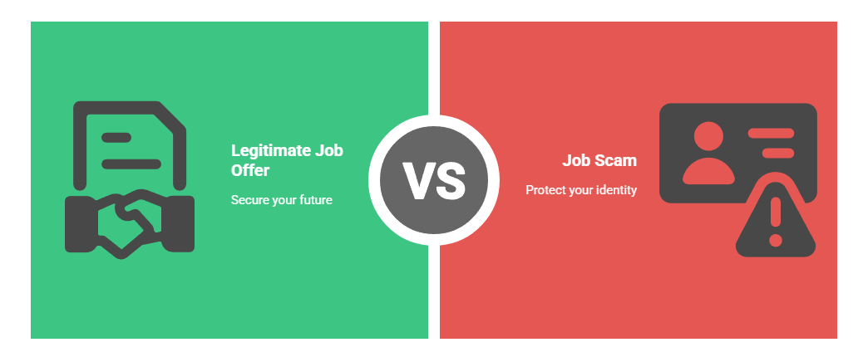
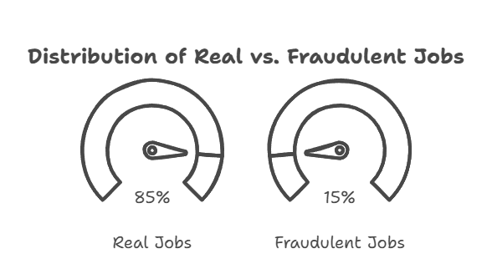
Problem Statement
🛑 Online job fraud has become a silent global epidemic.
🔒 Victims lose money, identity, emotional well-being.
📈 Rapid rise due to growth of remote & freelance job markets.

Slide 3
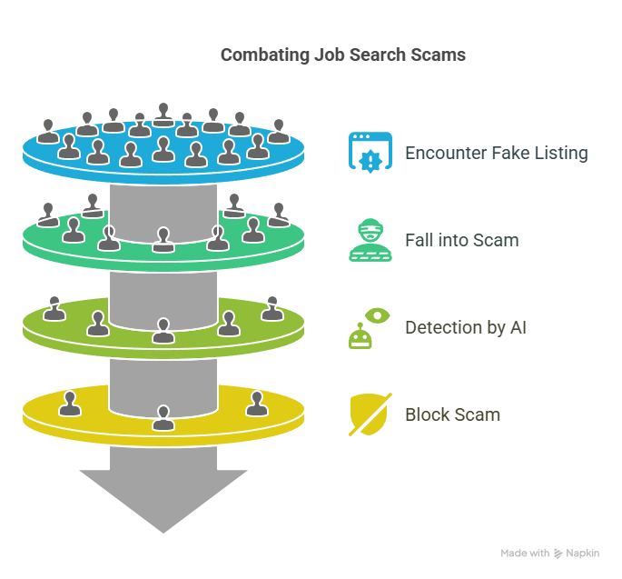
Significance
🌍 100M+ job seekers at risk
🚩 Existing job boards offer limited detection
🎯 We build a proactive, ML-powered fraud shield.

Slide 4
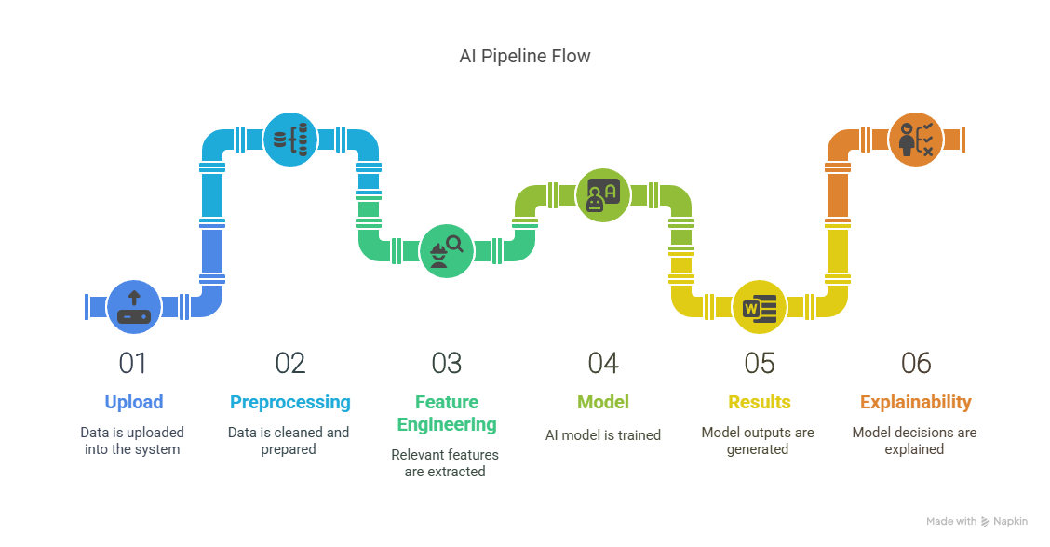
What Our App Does
✅ Upload job postings
✅ Auto-scan for scams
✅ Explainable results
✅ Dashboard insights

Slide 5
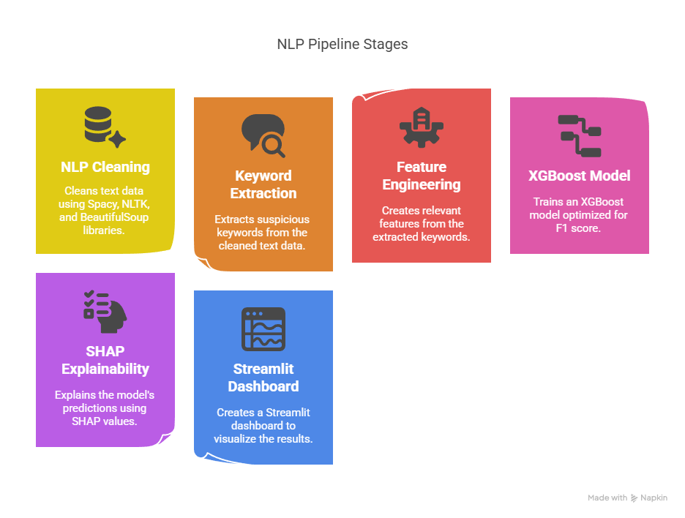
ML Pipeline
NLP Cleaning (Spacy, NLTK, BeautifulSoup)
Suspicious Keyword Extraction
Feature Engineering
XGBoost Model (F1 optimized)
SHAP Explainability
Streamlit Dashboard

Slide 6
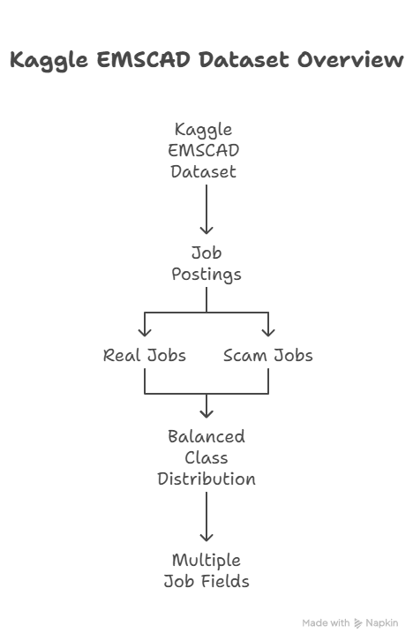
Dataset Overview
📂 Kaggle EMSCAD Dataset
18,000 job postings
800+ scams
Balanced class distribution
Multiple job fields

Slide 7
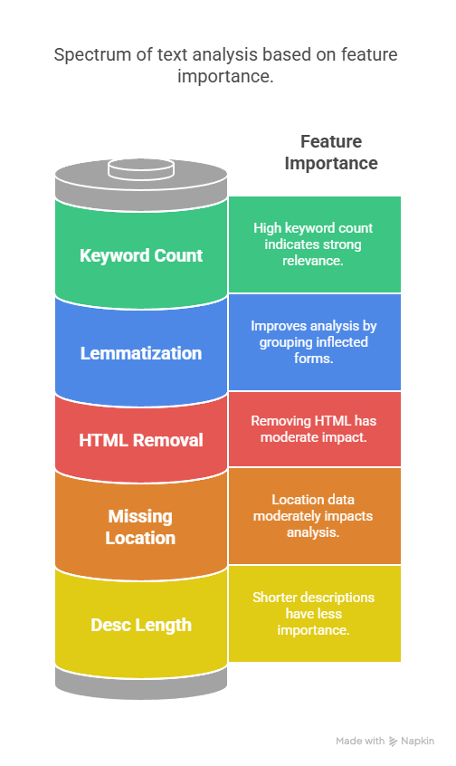
Feature Engineering
Features Extracted:
Desc Length
Keyword Count (wire transfer, urgent, upfront fee…)
Missing Location
HTML Removal
Lemmatization

Slide 8
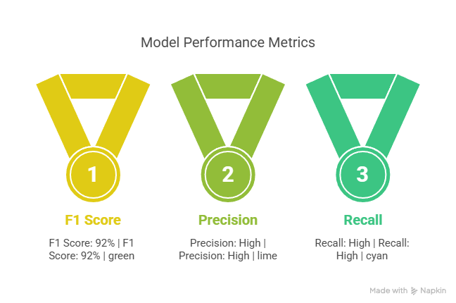
Model Performance
🎯 Metric: F1 Score (imbalance optimized)
✅ Achieved: F1 ~ 92%
🧪 XGBoost Classifier used with scaling.

Slide 9
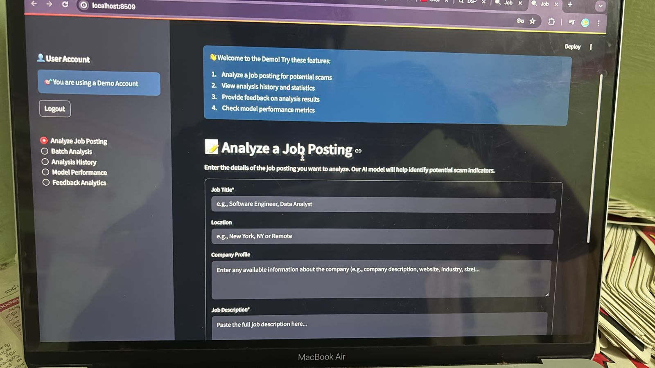
App Demo Dashboard
🌐 Streamlit App Features:
Upload CSV
Fraud Probabilities
Pie Chart for Fraud/Genuine
SHAP Explainability

Slide 10
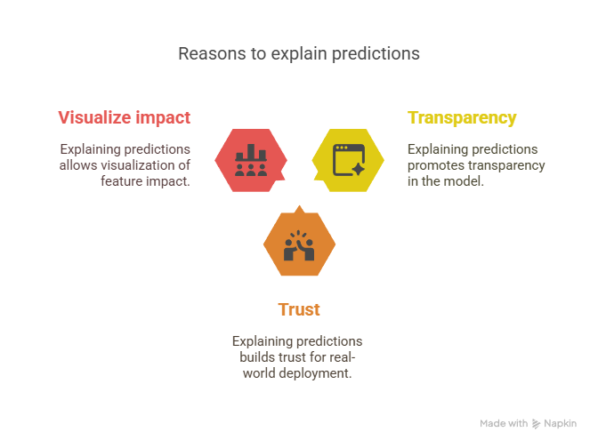
Explainability (SHAP)
🧠 Why explain predictions?
✅ Transparency
✅ Trust for real-world deployment
✅ Visualize feature impact

Slide 11
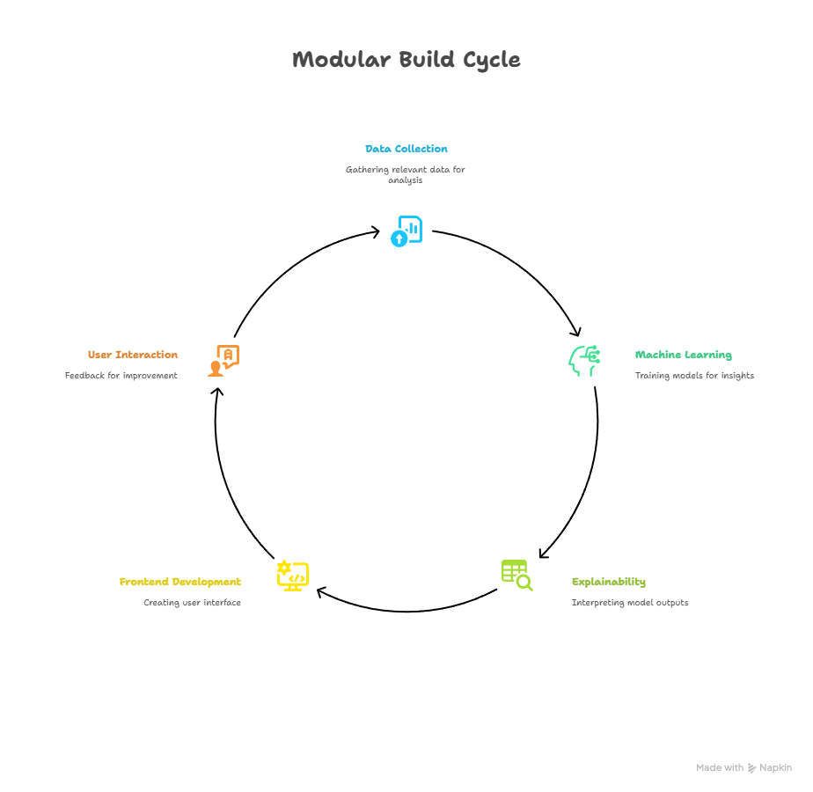
Architecture
📂 Modular Build
Pipeline folder structure
Reproducible & scalable

Slide 12
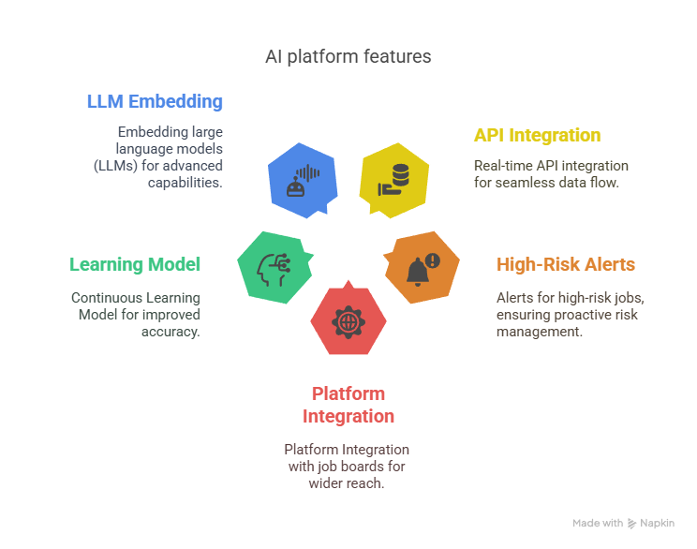
Future Scope
🔧 Real-time API integration
🔔 Alerts for high-risk jobs
🌐 Platform Integration with job boards
📈 Continuous Learning Model
🤖 Embedding large language models (LLMs)

Slide 13
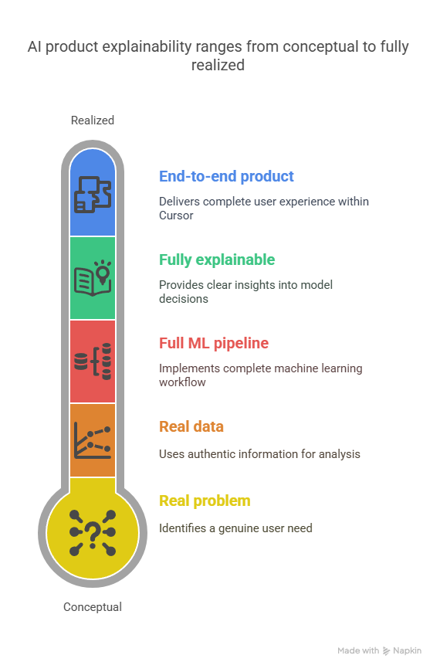
Summary
✅ Real problem
✅ Real data
✅ Full ML pipeline
✅ Fully explainable
✅ End-to-end product built inside Project

